Slide 1
Learn to 3D Print

Slide 2
Welcome to Open Workshops!
Notes:
Hello, everyone, and welcome to Open Workshops’ Intro to 3D Printing class! Let’s start out with introductions.

Slide 3
Introductions
Notes:
[Teacher introduction]
Been building and working with 3d Printers since the Mid-2000’s when the Memphis Makers I was with started building RepRap’s - a fully opensource FDM Printer.
Short for Replicating Rapid Prototypes)
Goal: Create an open-source 3D printer that could replicate its own parts.
This project inspired a global maker community and laid the foundation for the FDM hobbyist market.
- O.G. Nerd and been doing this for a while.
So, let’s go around the room and introduce yourself if you’re comfortable! Let’s get your name, level of experience with 3D printing, and a recent or favorite project of yours. It could be woodworking, electronics, sewing, art, writing - whatever!
[Introductions]

Slide 4
What is Open Workshops?
The mission of Open Workshops is to bring science, technology, engineering, and the arts to everyone by offering community-oriented crafting space and educational events which are open, accessible, and affordable to all.
Learn more or follow us online at www.open-workshops.com!
Notes:
So, before we dive into the class, some of you may be wondering what Open Workshops is. We’re a 501(c)(3) nonprofit dedicated to STEAM education and engagement, offering a community-oriented crafting space - this makerspace - and educational events like these. We’re supported primarily by our members; membership costs $25 a month and offers full use of the space and tools during open shop hours. If you’re interested in becoming a member, just talk to me after the class. No matter what, thank you all for supporting us by attending this class - if you find it valuable and want to see more like it, please tell others about us!

Slide 5
3D Printing 101
Notes:
Cover some basics like terminology, cost, types of printers, and use cases.

Slide 6
So… what is 3D Printing?
3D printing is a broad category of technology:
Builds a three-dimensional object by “adding” raw material
Can use a range of methods:
Deposit melted material
Bind together powdered material
Harden liquid material
This is different from machining:
Starts with raw material larger than the final part, and material is removed to make the object
Most power tools work this way (saws, drills, lathes, etc.)
Notes:
What is 3D printing? 3D printing (also called additive manufacturing, which just sounds more official) is a family of technologies for building a three-dimensional object by “adding” raw material. 3D printers can deposit melted material, bind together powdered material, harden liquid material, and more.
This is distinct from machining (also called subtractive manufacturing), where the process begins with a piece of raw material larger than the final part, and material is “subtracted” to make the object.

Slide 7
Why use 3D printing?
Why not use 3D printing?
Quick development from idea to physical item
More material-efficient than machining
Can produce more complex objects than are possible with machining
Low barrier to entry compared to CNC machining
Not all materials can be 3D printed
3D printed items can be less durable than machined items
For high-volume production, 3D printing is often slower
3D printing may not be precise enough for high-precision applications
Notes:
So why would you choose to use 3D printing instead of machining?
First of all, 3D printing can offer quicker development from an idea to a physical item. Especially if you’re familiar with 3D modeling software, or know someone who is, you can go from a general idea for an item to a physical print in a matter of hours, even if the item is complicated. With machining, there’s more work involved in determining tooling, setup, operations, etc.
Second, 3D printing is often more material-efficient than machining. Rather than taking a block of wood, plastic, or metal and turning most of it into chips, 3D printing uses only the material that goes into the final part, plus some additional material for support. Additionally, 3D printed parts are often mostly hollow, depending on the strength required - another thing that reduces the material required.
3D printing can also easily produce very complex objects - sometimes even objects that would be impossible to machine. We have some examples here you can hand around of 3D prints with captive or movable parts that were printed as one piece.
Finally, compared to other CNC technology - CNC being the general term for computer-controlled machines - 3D printing is inexpensive, compact, quiet, and safe, which makes it much easier to get started.
So, that all sounds great - you might ask, why don’t we use 3D printing for everything? There are a few reasons why we might choose not to use 3D printing for a particular project.
First of all, not all materials can be 3D printed; for example, glass and wood can’t be printed directly, and most consumer 3D printers are limited to plastics, so 3D printing with metal is out of reach for most folks. That said, in industry, you might be surprised by the range of materials that can be 3D printed - metal, ceramic, concrete, even food!
Second, 3D printed items can often be less durable than a machined part. That’s not to say 3D printed items are inherently flimsy - you can print some incredibly strong parts, and a lot of the time they’re plenty strong enough - but if you need something that’s extremely durable, 3D printing may not be the solution.
In addition, at scale, 3D printing is typically slower than machining or injection molding. This isn’t enormously relevant for home use, but you might still find yourself running up against this if you have a great item and want to print a bunch of them!
Finally, especially for FDM printers (we’ll get to that), they’re typically not precise enough for highly accurate applications. There are ways to improve the accuracy of a home printer, but generally speaking, if you want very tiny parts with extremely high dimensional accuracy, you may have a hard time getting there with 3D printed parts.
[TO DO: Engage with the class by proposing a few use cases and asking if it would be a good fit for 3D printing.]

Slide 8
Common Types of 3D Printers
FDM: Fused Deposition Modeling. Melted material (plastic) applied in lines - This is the main focus of this class
SLA (Resin): Stereolithography Apparatus. Liquid plastic cured by UV light
Many more types of 3D printers are in use in various industries - printing metal, wax, or even food!
Notes:
Okay - with common terminology out of the way, let’s talk specific technology. There are two common types of 3D printers on the consumer market: FDM (fused deposition modeling) printers squeeze melted plastic onto an item to build it up; that’s the least expensive type of printer, the type we have here, and the one we’ll primarily be talking about for the rest of the class. There is another type of printer, known as SLA (Stereolithography) and commonly called a “resin” printer, which uses an entirely different mechanism; we’ll talk about those briefly later, mostly so you know the difference.
There are a huge number of other types of 3D printers used in various industries that can print very large or accurate parts, or in some very interesting materials such as metal, wax, or even foods like chocolate - we’re not going to discuss those here, but there are great resources online if you want to know more!

Slide 9
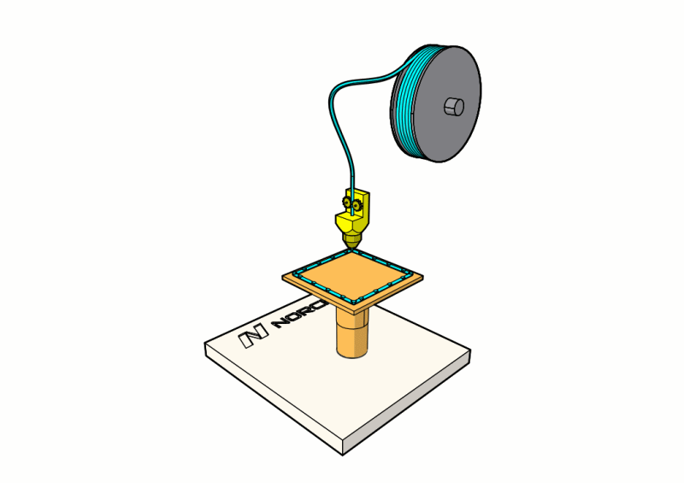
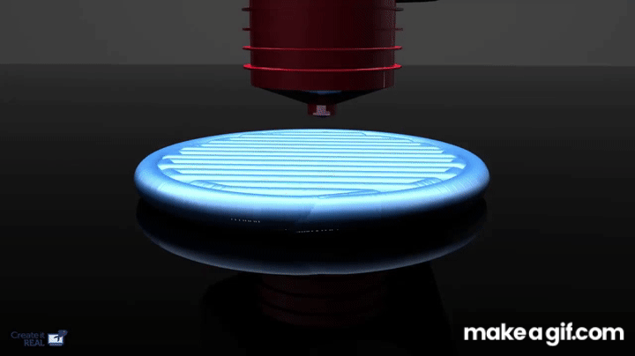
FDM 3D Printers
FDM = Fused Deposition Modeling
Uses a spool of thermoplastic filament melted and extruded through a heated nozzle
Builds objects layer by layer on a heated bed
Supports often required for overhangs
Lower resolution than resin printing, but larger build volume
Great for mechanical parts, prototypes, and functional prints that require durability
Easier, cleaner, and safer for beginners
Notes:
The first type of 3D printing we’ll talk about is FDM, or Fused Deposition Modeling, which is the most common and beginner-friendly form of 3D printing. FDM uses a spool of thermoplastic filament—usually PLA, PETG, or ABS—that’s melted in a hot end and extruded through a nozzle layer by layer to form your model. FDM printers are what most people picture when they think of 3D printing. The print head moves in X and Y directions while the bed moves along Z, building your object one layer at a time.
While FDM can’t match the fine detail of resin printing, it excels at larger, functional parts—like brackets, props, cases, and mechanical assemblies. It’s also less messy and safer to work with, since the materials are non-toxic and cleanup is simple.
The trade-off is resolution and surface quality—you’ll see visible layer lines, and small details can blur compared to resin prints. However, FDM printers typically offer much larger build volumes and a huge variety of filament materials (including flexible, composite, and heat-resistant types).
We’ll do a hands-on demo of basic setup, including filament loading, bed leveling, and running a calibration print to get everyone comfortable with the process.

Slide 10
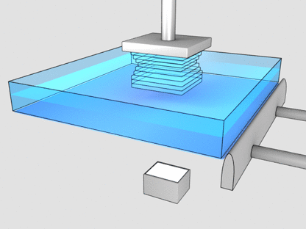
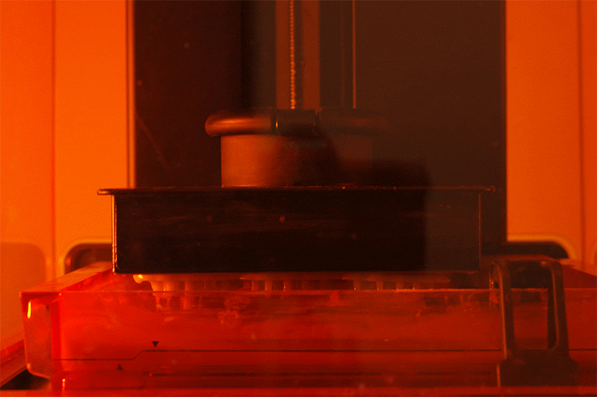
SLA (Resin 3D Printers
SLA = Stereolithography Apparatus
Uses a pool of liquid resin that’s hardened by UV light
Prints involve several stages (print > wash > cure)
Resin isn’t safe to touch, and wash is usually with alcohol
Much higher resolution than FDM for small-scale features (e.g. tabletop miniatures)
Often prints faster than FDM printers
Typically has smaller build volumes and other limitations (e.g. no internal cavities in models)
We plan to run a separate class on resin printing!
Notes:
Resin printing uses a pool of liquid resin that’s hardened by UV light. Prints involve several stages: the main print stage produces parts that are still covered in resin and not fully hardened; a wash in alcohol removes the excess resin, and then an additional curing phase with more UV light fully hardens the print. The resin itself is not safe to touch, which is one of the reasons I consider resin printing less safe than FDM printing.
There are upsides and downsides to resin printing: the biggest benefit is that it offers much higher resolution than FDM printing for small-scale features on items like tabletop miniatures or small sculptures. Resin printers are also typically faster than FDM printers, because they “print” an entire layer at once - although that’s offset somewhat by the additional wash and cure. However, resin printers typically have smaller build volumes, and they come with some other specific limitations, such as requiring solid parts (or drain holes).
Our hope is to run a class specifically on resin printing once we get a resin printer - if that interests you, let us know!
Faster because prints entire layer at the same time vs FDM that must travel the entire layer.
Bring Miniatures for Examples..

Slide 11
How much does 3D printing cost?
A balance of price point vs. amount of fiddling and configuration required:
$150 - $300: A project car. Entry-level, often have upgrades and customizations available but some tinkering is required
Creality Ender 3 V2: $200
Elegoo Neptune 3: $250
$300 - $1,000: A new sedan. Generally going to work out of the box, be more reliable, and offer better direct support, with upgrades pre-installed
Bambu A1 Mini: $300
Prusa i3 (Kit): $650
Bambu P1S: $650 ($850 with AMS)
$1,000 - $10,000: A sports car. Top of the line; very powerful, excellent support, often have specific features (dual extruders, large print volumes, automatic cleaning)
Bambu X1 Carbon: $1,200 ($1,450 with AMS)
Bambu H2D: $1,900
LulzBot Workhorse: $3,000
Most common filament (PLA, PETG, ABS) is inexpensive, under $20 for a 1-kilogram spool (which usually lasts a while!)
We have a variety of printers so you can try different price points!
Notes:
FDM vs SLA = Printers are about the same price in similar categories. But the material costs are going to be much higher for SLA.
Resin: $30-$300 per liter depending on type, size, and brand.
Filament: $20-$70 per kilogram
2x – 4x price difference in typical builds.
Be sure to factor in maintenance and other stuff
Like owning a car – you don’t just buy it and your done.. You have to put money into the upkeep.
ie IPA for washing and UV curing equipment
Filament Dryers and storage options
Replacement parts ➔ like any machine = will need replacement parts

Slide 12
FDM Printers
Notes:
Why FDM?
Good Starting options

Slide 13
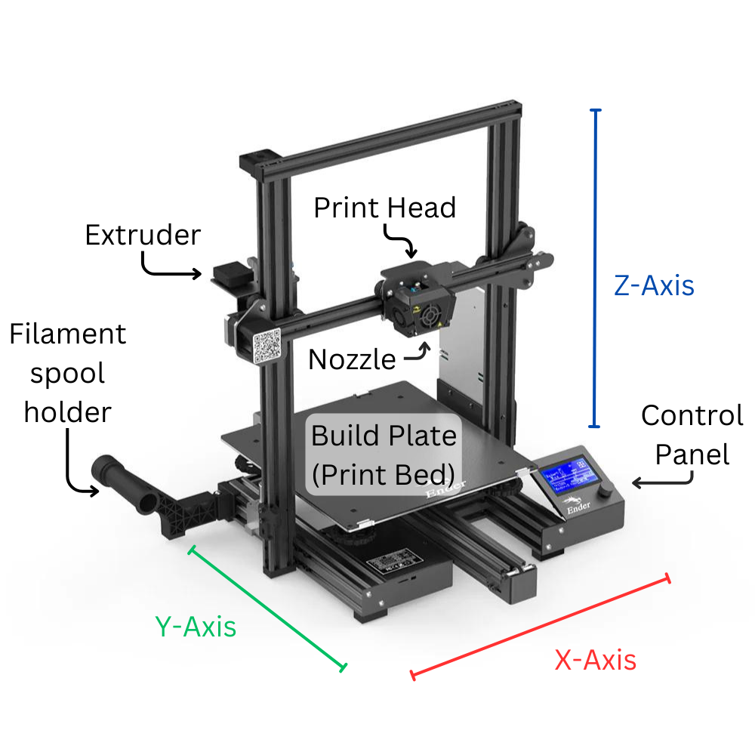
Parts of an FDM Printer
Frame
Build Plate
Extruder
Print Head
Nozzle
Stepper Motors
Belts, Pulleys, & Endstops
Lead Screws
Linear Rails
These parts are present in some form on almost all FDM printers
Notes:
Let’s talk a bit about the parts of an FDM printer specifically. FDM printers have a build plate, also called a print bed; that’s the area where melted filament is deposited for the first layer, which sticks the part down to the bed. The bed is usually heated, which helps the part stay stuck down while printing. The bed itself is typically made of coated glass or metal - something that the filament sticks to when warm, but hopefully comes off of when cool!
The Ender 3 Max uses a Cartesian motion system — one of the most common layouts for hobby FDM printers. The term “bed slinger” refers to the print bed moving forward and backward (Y-axis) while the print head travels left/right (X-axis) and up/down (Z-axis).
Found in Ender, Prusa, and Anycubic i3 style printers.
Simpler mechanically, but bed motion can cause vibration at high speeds.
CoreXY Motion System -- The print bed moves only on the Z-axis (up and down). The print head moves in both X and Y axes using a belt-driven gantry.
Common in Bambu Lab, Voron, and Prusa XL printers.
Faster and more precise since the bed is stationary during layer changes.
Reduced ringing/ghosting on prints.
Better for tall or heavy models (no inertia from bed motion).
FDM printers will also have a print head; this is the part of the printer which heats and melts the filament. It also contains the nozzle, which is a threaded component with a very tiny hole (often 0.4mm, but you can get other sizes) that the plastic flows through. [Hand around nozzles.] An FDM printer will also have an extruder; this may be attached to the print head in some models, which is called “direct drive”, or - like this printer - it may be mounted to the printer frame with the filament guided to the print head through a tube, a setup called a Bowden system.
Every 3D printer will also have some way to move the part in three dimensions relative to the print head, called the X, Y, and Z axes. For this style of printer, the X axis is provided by the print head moving left and right across this rail, and the Z axis is provided by the rail itself moving up and down - but the Y axis is actually provided by the print bed moving back and forth, rather than the print head itself. The typical term used for this style of printer is a “bed slinger” - for obvious reasons! These are some of the most common entry-level printers available. The maximum travel in each of the dimensions defines the build volume - the total space available for printing, which defines the maximum size object that can be printed.
Finally, printers will generally have some form of filament spool holder to hang a spool of filament on as it’s pulled into the extruder, and some kind of control panel or interface to control the printer.
There are a lot of different designs of FDM printers, but with very few exceptions, they’ll all have these basic elements present somewhere!

Slide 14
Types of Filament
Material | Found In | Price | Safety | Durability | Ease of Printing
PLA | Disposable cutlery, food trays | $ | ★★★ | ★ | ★★★
PETG | Pop bottles, packaging | $ | ★★ | ★★ | ★★
ABS | Consumer products (e.g. Lego) | $ | ★ | ★★ | ★
ASA | Car parts | $$ | ★ | ★★★ | ★
Lots of more exotic materials, too, with higher prices and more specific uses:
TPU: Flexible material for phone cases, gaskets, etc.
PA (Nylon): Very durable and hard-wearing but tricky to print
“Filled” filaments: Any other material with wood, metal, glass, carbon fiber, etc. added; typically require special nozzles
Notes:
First of all, let’s talk filament! These acronyms are thrown around a lot in the 3D printing world, and understanding what they mean is a big help. Each acronym is a shortened version of a long chemical name that I’m not going to bother with, but if you’re into chemistry, feel free to look them up online! There are a few common types of filament used in consumer printers; we’ve got those laid out in a table here, ordered by safety and ease of use.
First of all, perhaps the most common type of filament (and the one we’re using today) is PLA. PLA is actually a bioplastic made from plant starch; as such, it’s often used for disposable cutlery, food trays, etc. It’s important to note that while it’s a bioplastic and breaks down faster than traditional plastics, it is not compostable and still takes a very long time to break down. PLA is very inexpensive and very safe to print with; it doesn’t produce any harmful gases, and the extruder temperature required is lower than most other plastics. It’s also very easy to print with and generally quite forgiving - it doesn’t warp significantly or struggle with adhesion. On the flip side, though, PLA is one of the less durable plastics. That’s not to say it’s soft or weak - I printed a coat hook from PLA two years ago and it’s still going strong - but it’s not quite as rigid or durable as some other materials.
Next up is PETG. This is the same plastic pop bottles and other clear packaging are made from. PETG is also very inexpensive, and generally safe to print - it doesn’t produce any gases - but it does require higher extruder temperatures, and in my experience it can be very sharp, so it loses a point on safety. It gains a point on durability, though; PETG is generally harder and more rigid than PLA. In terms of printing, it’s not particularly difficult, but does come with a few quirks that you need to look out for.
The third very common filament is ABS. This is one of the most common plastics; you use items made from ABS every day. As with the previous filaments, ABS tends to be very inexpensive; but as mentioned previously, it produces harmful gases while printing that require venting or filtration. ABS is also trickier to print; it requires higher temperatures and tends to warp. The upside, though, is that ABS is a very durable material, with one exception: it breaks down quickly when exposed to UV light - also known as sunlight - so it’s not suitable for use outdoors.
Finally, ASA is a filament that’s somewhat less common, but still worth discussing. It’s a variant of ABS and has essentially the same tradeoffs, with the exception of also being UV-stable, so it can be used for items outdoors or in direct sunlight. That extra benefit does come with some additional cost, though; ASA typically costs about 50% more than ABS.
All of these filaments are common enough to be offered with a frankly dizzying array of colors and variations - great for consumer choice, but somewhat trickier to get started with.
Finally, there are lots of other more exotic filaments with increasingly higher prices, specific uses, and particular printer configurations required. Some honorable mentions: TPU is a flexible material that can be used for phone cases or gaskets; nylon is an extremely durable and hard-wearing plastic; and most of the filaments in the table above come with “filled” options - which basically means it’s a base plastic with fiber or powder of another material added, such as wood, metal, glass, or carbon fiber. These are often tricky to print, requiring special nozzles, and have additional safety concerns, but can produce some very neat effects.
Whew… that’s a lot! What’s the short version? Well, if you’re just getting started, I strongly recommend you stick to a basic PLA and only branch out from there when you run into something you can’t do with it. That’s what I do, and so far I’ve found very few things PLA can’t do!

Slide 15
Printing, Start to Finish
Notes:
Alrighty - now that we know how FDM printers work and what the general parts are, let’s demonstrate the process of printing something from start to finish. I don’t expect anyone who isn’t familiar with this process to leave this class able to repeat this - the goal here is to give you an understanding of the process so you know what to expect and where to start. We do plan on offering a longer, more in-depth class or workshop covering this process which will give everyone more hands-on experience - if that’s something you’d be interested in, please let us know. In the meantime, if you’re struck with a creative spark and want to print something, come on in during any of our open shop hours and a staff member will be happy to help you through this process and get your print going.

Slide 16
Getting a File
Two common ways of getting a file you can 3D print:
Websites: Thingiverse, Sketchfab, Cults 3D, Bambu MakerWorld, etc.
Design and model it yourself: Autodesk Fusion, TinkerCAD, Sketchup, etc.
3D files for printing typically use the STL (stereolithography) file type
3D files must be “sliced” before printing
This is like the “print properties” for document printers
This is done using a slicer program such as Cura, PrusaSlicer, or Bambu Studio
Slicing generates printer-specific G-code files
These files contain the individual commands telling the printer how to move each motor
These are plain text files - try opening one in Notepad!
Notes:
Alright, say you’ve got an idea and want to print something out. What does that process look like?
First up, most there are two common ways of getting a file you can 3D print. The easier option is to use one of many websites that offer print files, such as Thingiverse, Sketchfab, GrabCAD, and more. You can just type what you’d like to print into a search bar to see if anyone has created a similar idea already, then download the files - often for free. There are thousands upon thousands of 3D objects to print out there, including lots of useful, fun, and well-designed files. Let’s open up Thingiverse and look for a few models
If you don’t find what you’re looking for online, or the files available aren’t quite what you had in mind, there’s also the option to design and model the object yourself using a free 3D modeling program such as Blender or a free CAD program such as Fusion 360. The topic of designing and modeling objects specifically for 3D printing is an entire discipline - way too much to get into during this introductory class - but we plan to offer a series of classes on that exact subject using Fusion 360, so if that’s something you’re interested in, please let us know!
Typically, the file you’ll get - either downloaded from a website or exported from a modeling program - will be an STL file, although there are other file types you may run into. Just know that if you see an STL file type, that file contains a representation of a 3D object.
Unfortunately, we can’t just take that STL file and send it to a printer - there’s an intermediate step, called “slicing”, that we need to do first. That’s because while the STL file contains the shape of a 3D object, there are a lot of options available for how that object prints, and the best selections for many of those options will vary depending on the exact printer, filament, and model. You can think of this “slicing” step like the “print properties” step of printing a document onto a piece of paper - you may have a PDF or image you want to print, but you need to tell the printer what quality to print at, what size to print, whether to use grayscale or color, and so on.
This slicing process starts by opening the STL file in a slicer software program. Each 3D printer typically has their own slicer software, but there are a few industry standards, such as Cura and PrusaSlicer, that work with almost any printer on the market. We use Cura here at Open Workshops.

Slide 17
Common Slicer Settings
Printer selection
Sliced G-code files are not generally shareable across printer models
Filament material
Different filaments require different settings
Print quality / layer height
Recommend starting with default (typically 0.2mm) and adjusting as needed
Infill
15% - 50% depending on required strength
Orientation
Which direction you face down - affects quality, strength, and required support
Supports
Follow recommended settings from the model; use supports if not mentioned
Bed adhesion
A brim can help small objects stick to the build plate
A raft prints the entire part on a platform of support
Notes:
Before we open the program, let’s talk about a few of the options we’re going to encounter in our slicer.
First up, the most important step is to make sure you’re using a profile designed for your specific printer. Different 3D printers can be set up very differently, so sliced files for one model of printer will likely not work on others.
Once you’ve verified you’re slicing your file for the right printer, the next most important selection is which filament you’re using. Different filaments require different temperatures and speeds; selecting the wrong filament in the slicing step can result in poor print quality or a print that just doesn’t work.
Next, we need to select our desired print quality. This is really a shorthand for configuring a range of settings, but the most significant is typically layer height - how tall each layer of plastic is. A lower print quality will print with thicker and more obvious layers and may have more minor flaws and less strength, but will print faster. Higher quality prints typically have thinner and less apparent layers and flaws, but take longer to print. I typically recommend starting in the middle with a standard quality profile and deciding from there if a lower or higher quality is needed.
Once you’ve selected your quality, there are a few more settings that are going to be based more on the model or what you plan to use it for. First, we need to decide what infill density to use. Infill density determines how much plastic is printed inside your object. A high infill density - around 50% - results in parts that are stronger and more rigid, but take more time and filament to print. That’s a good choice for parts that are going to be functional or handled frequently. A lower infill density - around 15% - results in parts that aren’t as strong, but are lighter and quicker to print. That’s a good choice for objects that are large, decorative, or prototypes.
Next, we need to consider orientation and support - two concepts which go hand in hand. A 3D printer can’t print in thin air; it must always print on top of another layer of plastic. For objects with unsupported areas - called overhangs - we need to include support structures, which are printed material that provides a foundation for those areas of the print, but that can be easily removed after printing. A big part of designing items for 3D printing is minimizing the amount of support required. Thankfully, most models found online will come with suggested orientation and support settings, but a general recommendation is to orient the part to minimize overhangs and include support if there are large unsupported areas highlighted on the model. Keep in mind that the print quality and strength will typically be worst in the Z-axis, so if you want to capture detail or ensure strength in a particular direction, it may be worth orienting for that and printing with more support.
Finally, one last consideration is bed adhesion. Very small models, or models that only touch the build plate in small areas, may not adhere enough to ensure a complete print. For these models, you’ll typically want to print with a brim, which is extra plastic printed around the areas that touch the build plate. For models that require even more structure, a raft will print a sheet of material under the object, raising the item off the print bed entirely.
Whew - that’s a lot. Let’s open up Cura and see what these settings look like in the wild.

Slide 18
Demonstration - Slicing and Printing
Notes:
Okay, enough of that… let’s get into the subject at hand: 3D printing. We’ll start with “3D Printing 101” - some definitions and explanations of 3D printing in general.

Slide 19
Safety Briefing
One of the benefits of FDM printing is that it’s relatively safe!
Nozzle is hot (200 C / 400° F) - don’t touch it!
Keep fingers away from moving parts
Some filaments (e.g. ABS) require ventilation or filtration
We’re safe using PLA and PETG - we’ll discuss types of filament later!
Notes:
Okay, as always, before we turn on a machine, let’s talk safety. Thankfully, one of the major benefits of FDM printing is that it’s really quite safe! That said, there are still a few things to keep in mind while setting up and working with a 3D printer.
First of all, the extruder inside the print head is very hot - usually 200 C or hotter. Most 3D printers shield this component with silicone and plastic so it’s very difficult to accidentally touch it directly while it’s hot, but still - be careful, and make sure the printer has cooled down fully if you need to disassemble the print head.
Next up, being a CNC machine, the printer is going to move suddenly and potentially unpredictably. It’s best to keep your fingers and hair away from the pulleys and stepper motors to avoid any pinching.
Finally, some 3D printing materials produce gases you don’t want to breathe; when you’re printing these filaments, you need a vented or filtered enclosure. We’ll discuss different materials in more detail later, but for now, rest assured we’re safe with the material we’re using, which is called PLA.

Slide 20
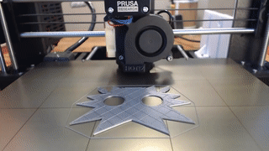
Starting the Print
Load the g-code file to the printer
Load filament
Level the bed (if required)
Prep the bed (if required)
Press “Print”!
Keep an eye on the first layer
Wait!
Notes:
Alright, we finally have a g-code file to print! Now what?
The first step is to get that file to your printer. For newer or more expensive printers like our P1S, that may be handled automatically over WiFi; in our case, we need to copy that file onto a MicroSD card and plug it into the front of the printer.
Before we can print, there are a few things we need to prepare. First, we need to ensure the correct filament is loaded into the printer. If we need to change the filament, your printer will have a menu option which heats up the extruder and extracts the filament; you can then pull it out the rest of the way and store the roll, then feed the correct filament in until it comes out of the nozzle. Our P1S has a system for automatically changing between four different filament types or colors, which saves us from having to change between common filaments.
If your printer is a less expensive model, it may require leveling the bed before printing. That involves moving the extruder to various locations on the build plate and adjusting the knobs under the build plate until there is a consistent spacing between the plate and nozzle, typically using printer paper as a spacing guide. Our bed is already leveled, so we’re good to go there. More expensive printers like our P1S will typically handle bed leveling automatically, so this isn’t something you’d need to worry about.
Depending on the type of build plate and filament, it may be beneficial to perform some additional preparation of the bed to help the filament adhere. Common techniques include painter’s tape, sprays, or glue sticks - we often use purple Elmer’s glue sticks when printing PLA on a glass build plate, for example. This often isn’t necessary with new printers, so I’d recommend only looking into these options if you have trouble with the first layer not adhering to the build plate.
Finally, we print! The printer will heat up the build plate and extruder, then start printing. We’ll want to keep an eye on it to make sure the first layer sticks down nicely; if it doesn’t, we can cancel the print, clean away the filament, and then either re-level the bed or apply a bed prep technique before trying again. More expensive printers include cameras or even lidar that can detect when things aren’t printing correctly and automatically stop printing, which is a great feature that can save a lot of trouble!

Slide 21
And now, we wait!
Notes:
And now, simultaneously the best and worst part of 3D printing - we walk away and let the printer run, and come back when it’s done!

Slide 22
A few more topics while we wait…
Notes:
In the meantime, let’s discuss a few miscellaneous topics related to 3D printing.

Slide 23
Handouts & Questions
Notes:
Our 3D print should be done by this point; we’ll put it in the handout box. Everyone is welcome to take a print from the box - you can use these to tell your friends and coworkers about what you learned today!
Before we wrap up, we have some time for questions - fire away!
[Take questions from the class.]

Slide 24
Thanks for coming!
We hope to see you in another class soon!
Notes:
Let’s wrap up - thank you everyone for coming to this Open Workshops class! You’ll all be receiving a short survey via email asking what you liked and thought we could improve on this class - if you can take a few minutes to fill it out in the coming weeks, it’s a huge help to us as we try to improve our programming.
Drive safe!

